Slide 1
Histogram Equalization

Slide 2
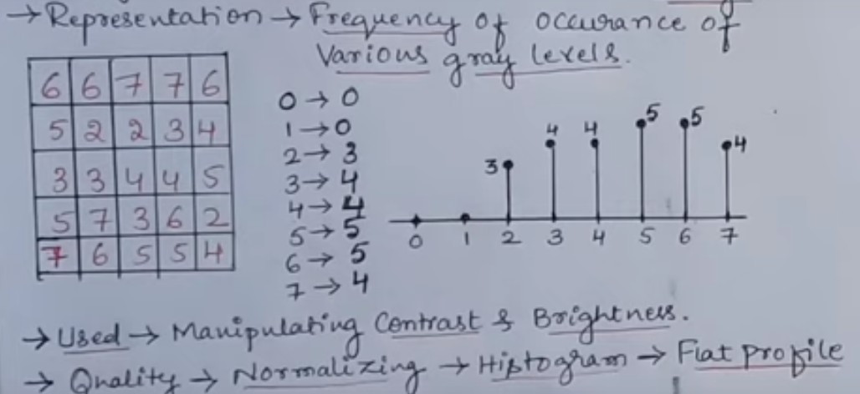
Example

Slide 3
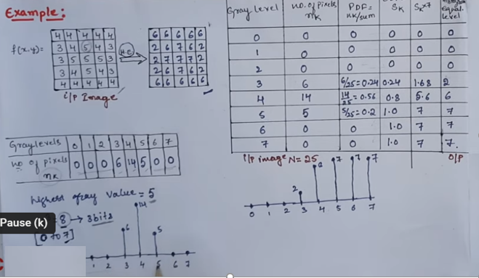


Slide 4
def get_pixel_frequency(image):
pixel_frequency = np.zeros(256)
for row in range(image.shape[0]):
for col in range(image.shape[1]):
pixel_val = image[row][col]
pixel_frequency[pixel_val] += 1
return(pixel_frequency)

Slide 5
pixel_pdf = pixel_freq/np.sum(pixel_freq)
pixel_cumsum = np.cumsum(pixel_pdf)
bits_cumsum = (L-1)*pixel_cumsum
pixel_map = np.fix(bits_cumsum).astype(int)

Slide 6
for row in range(output_image.shape[0]):
for col in range(output_image.shape[1]):
pixel_val = input_image[row][col]
output_image[row][col] = pixel_map[pixel_val]

Slide 7
Thank You

